Slide 1

Case study: Specialize mobile Martial arts app
Robert Jackson
Click to unlock

Slide 2

Table of Contents
In this case study we’ll explore the steps taken to address the problem(s), and solution for the martial arts school.
Understanding
the user
01
Starting
the design
02
Refining
the design
03
Going forward
04

Slide 3
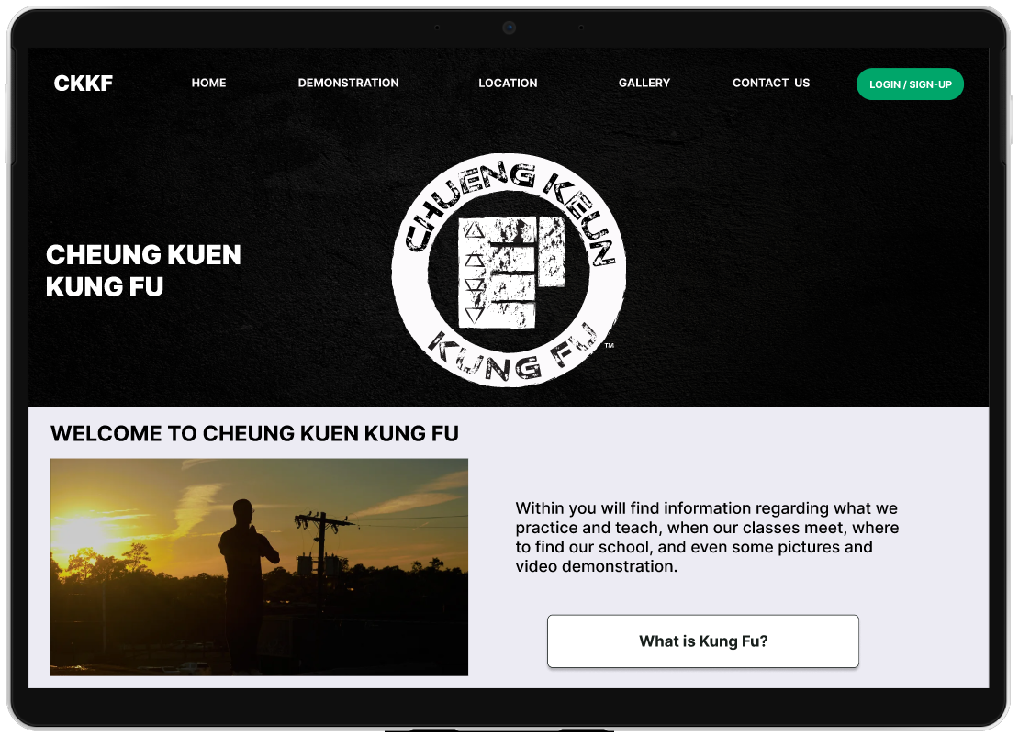

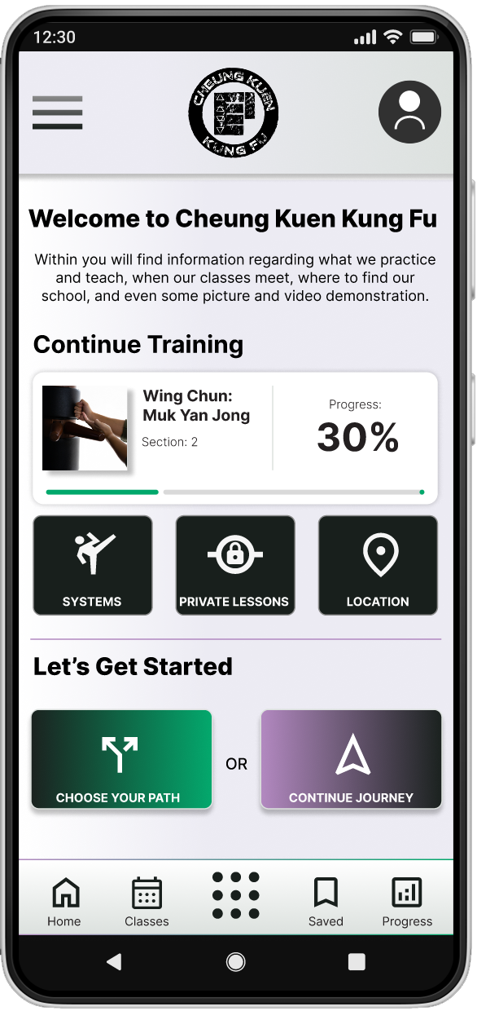
Project overview
The product:
Design a specialized mobile app for a martial arts school.
Project duration:
5 Months
Aug. 2024 - Jan. 2025

Slide 4

Project overview
The problem:
Students and practitioners are not always able to make it to class always. Obligations such as work, family, exhaustion, etc. plays a factor to why they can’t make it to class
The goal:
Design an Martial Arts App will let users access classes and tutorials which will affect users who can't make it to classes by helping users get and maintain fitness, stay up to date on missed classes / demonstrations, and maintain training routine.

Slide 5
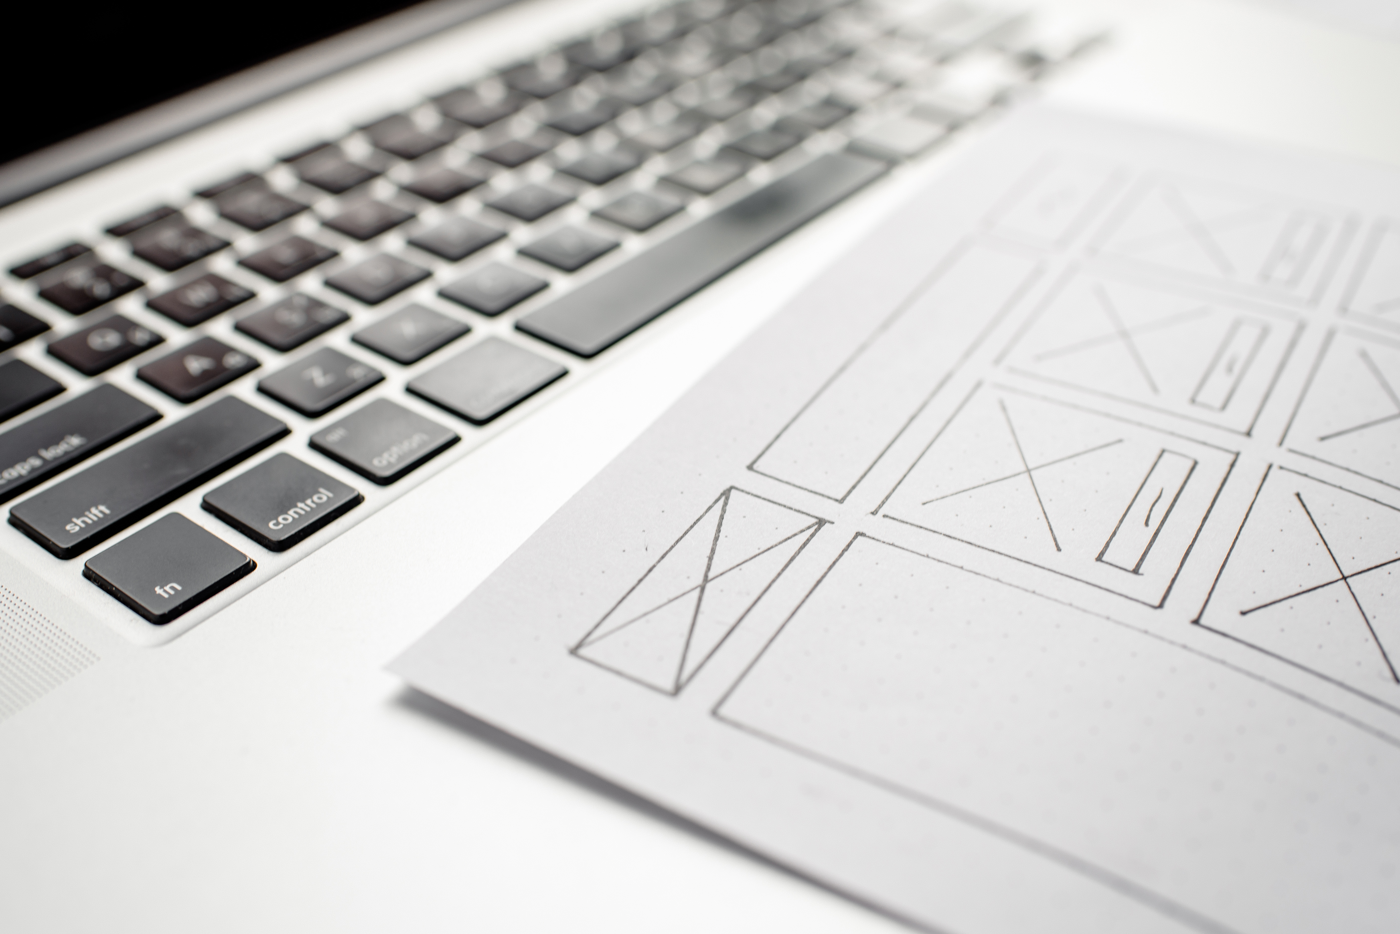
Project overview: Roles & Responsibilities
My role:
lead UX designer
UX researcher
Responsibilities:
As the UX Design and Research Lead for this project, I was responsible for the full UX design process. My duties included conducting user research (gathering feedback from fellow martial arts students), creating user personas, affinity diagramming, developing user journeys, leading rapid sketching exercises, storyboarding, wireframing, prototyping, iterating on designs, and user testing.

Slide 6


User research
Personas
Problem statements
User journey maps
Understanding
the user

Slide 7
User research: Summary
Studies show that most martial arts schools do not have a specific app for their students. Although almost all schools have websites, many contain outdated information and non-functional links. Students frequently encounter barriers that hinder their ability to attend classes, such as conflicts in scheduling, traffic issues, exhaustion after work, family obligations, and travel. To address these difficulties, a dedicated martial arts app would significantly aid those who cannot attend for various reasons, enabling them to keep up with their lessons and improve their health and skills.

Slide 8
User research: pain points
1
2
3
4
5
Traffic
Fatigue
Time / Schedule
Motivation
Distance
Adults commute one-way travel time was 26.8 minutes. 8.9% commuted one-way was 60 minutes or more in 2023, according the
Census Bureau.
Fatigue from work and commuting back and forth plays a role to students missing classes.
Different Work schedules, school classes and events, etc. makes attending class not possible.
It can be difficult to keep motivated to keep up with training.
Relocating to a different city or state. Users would have to find new school to train, which the user will have to ‘start over’ or not continue training

Slide 9


Persona: Jay
I want to attend class. However, after working and navigating through traffic to get home, I feel too exhausted to head out again for training.
Frustrations:
Goals:
Traveling straight home from work to class isn't always practical and can be exhausting.
A mobile application to inform them about the lessons they have not attended.
Jay
AGE: | Late 30s – early 40s
EDUCATION: | Bachelors
HOMETOWN: | Tallahassee, FL
FAMILY: | 1 wife, 3 children
OCCUPATION: | State worker
Problem statement:
Jay, a state employee, is looking for an application that will keep them updated on the lessons they have missed, as traveling straight from work to class can sometimes be inconvenient and tiring.

Slide 10
User journey map
Persona: Jay
Goal: A way to stay up-to-date with Martial arts training
ACTION | Open Martial arts app | Browse to view different workouts | Select style / System | Start lesson of style / system | Complete lesson
TASK LIST | Tasks A. Log in to homepage B. view progress, or C. Start new style | Tasks A. browse workouts in middle menu B. select warmup / workouts | Tasks A. Select style from options B. Start video | Tasks A. Start Training | Tasks A. video autoplays to next video B. Close app
FEELING ADJECTIVE | Not too sure if they will make it to class on time in-person | Was confused on where to find warmups. Trying to figure where to find specific workout | User liked the video. Asked if there will be captions to not disturb family, and brief description of the style | Was a bit annoyed that they couldn’t save or bookmark video | Was happy that they complete workout. Asked if there will be an option to book time to ask questions, etc.
IMPROVEMENT OPPORTUNITIES | Create a mobile app that have training videos of his martial arts class | Add section that user can easily find workouts, will add icons | Add closed caption option to video for users who need, as well as description of style(s) | Add a bookmark or favorite button so user can easily access, instead of scrolling to video. | Look to add option for private lesson(s) should user can’t make it to class in-person
Charting Jay's user journey illustrates the convenience for users to access video lessons and tutorials from martial arts schools through the app, especially when they are unable to attend in person.
Image of user journey map

Slide 11
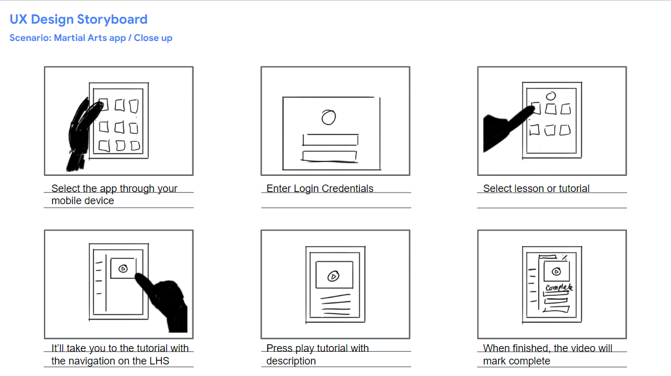
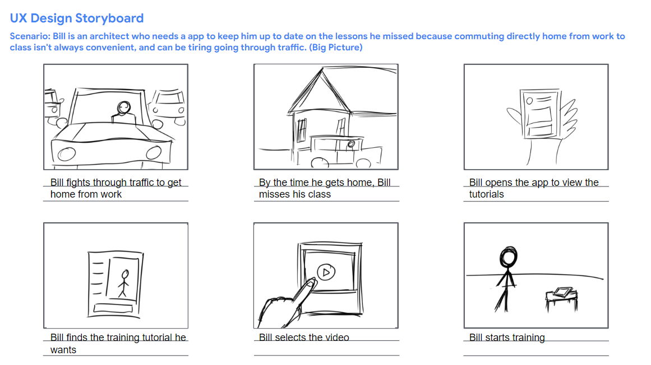
User journey: Storyboards

Slide 12

Paper wireframes
Digital wireframes
Low-fidelity prototype
Usability studies
Starting
the design

Slide 13
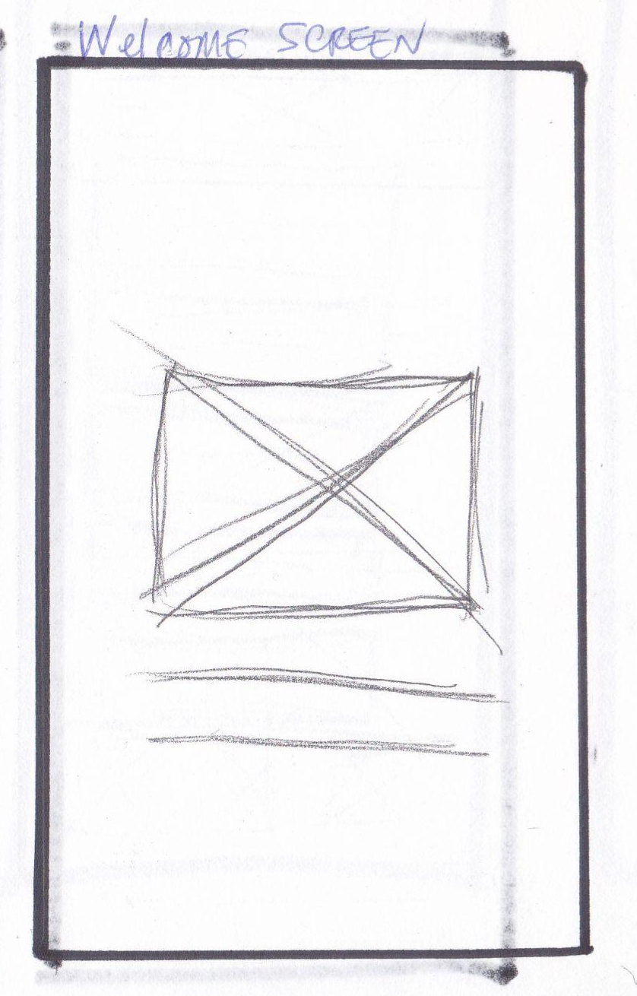
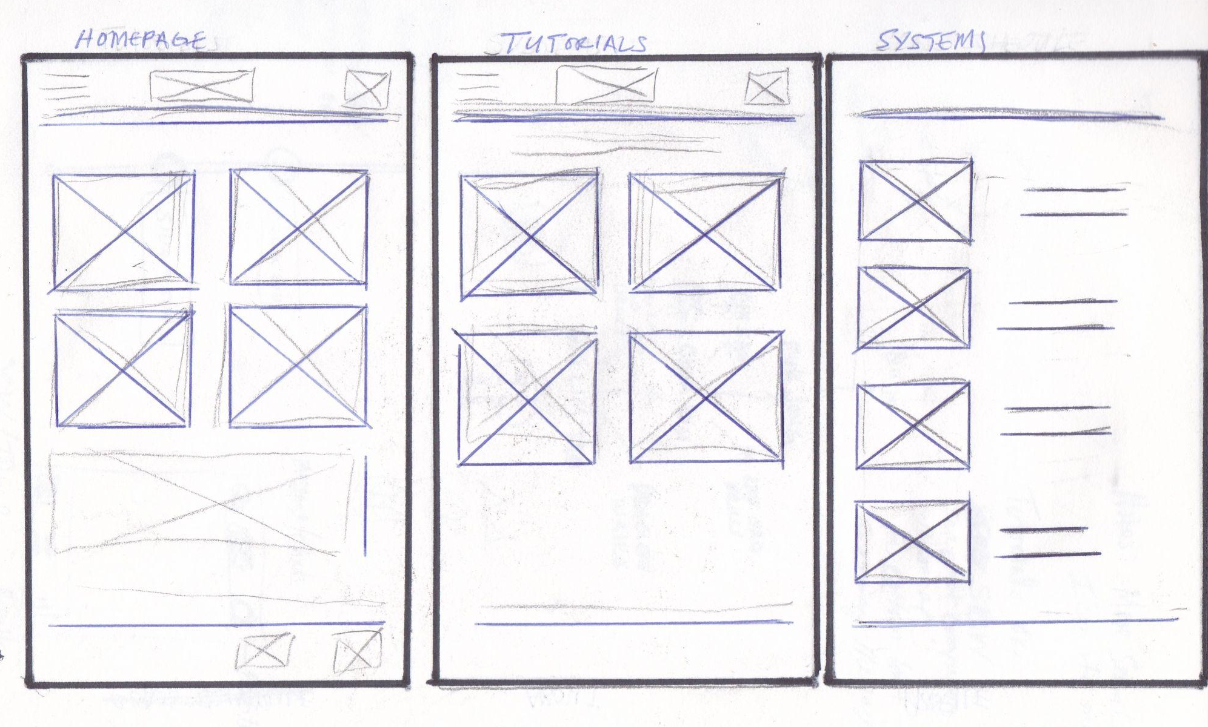
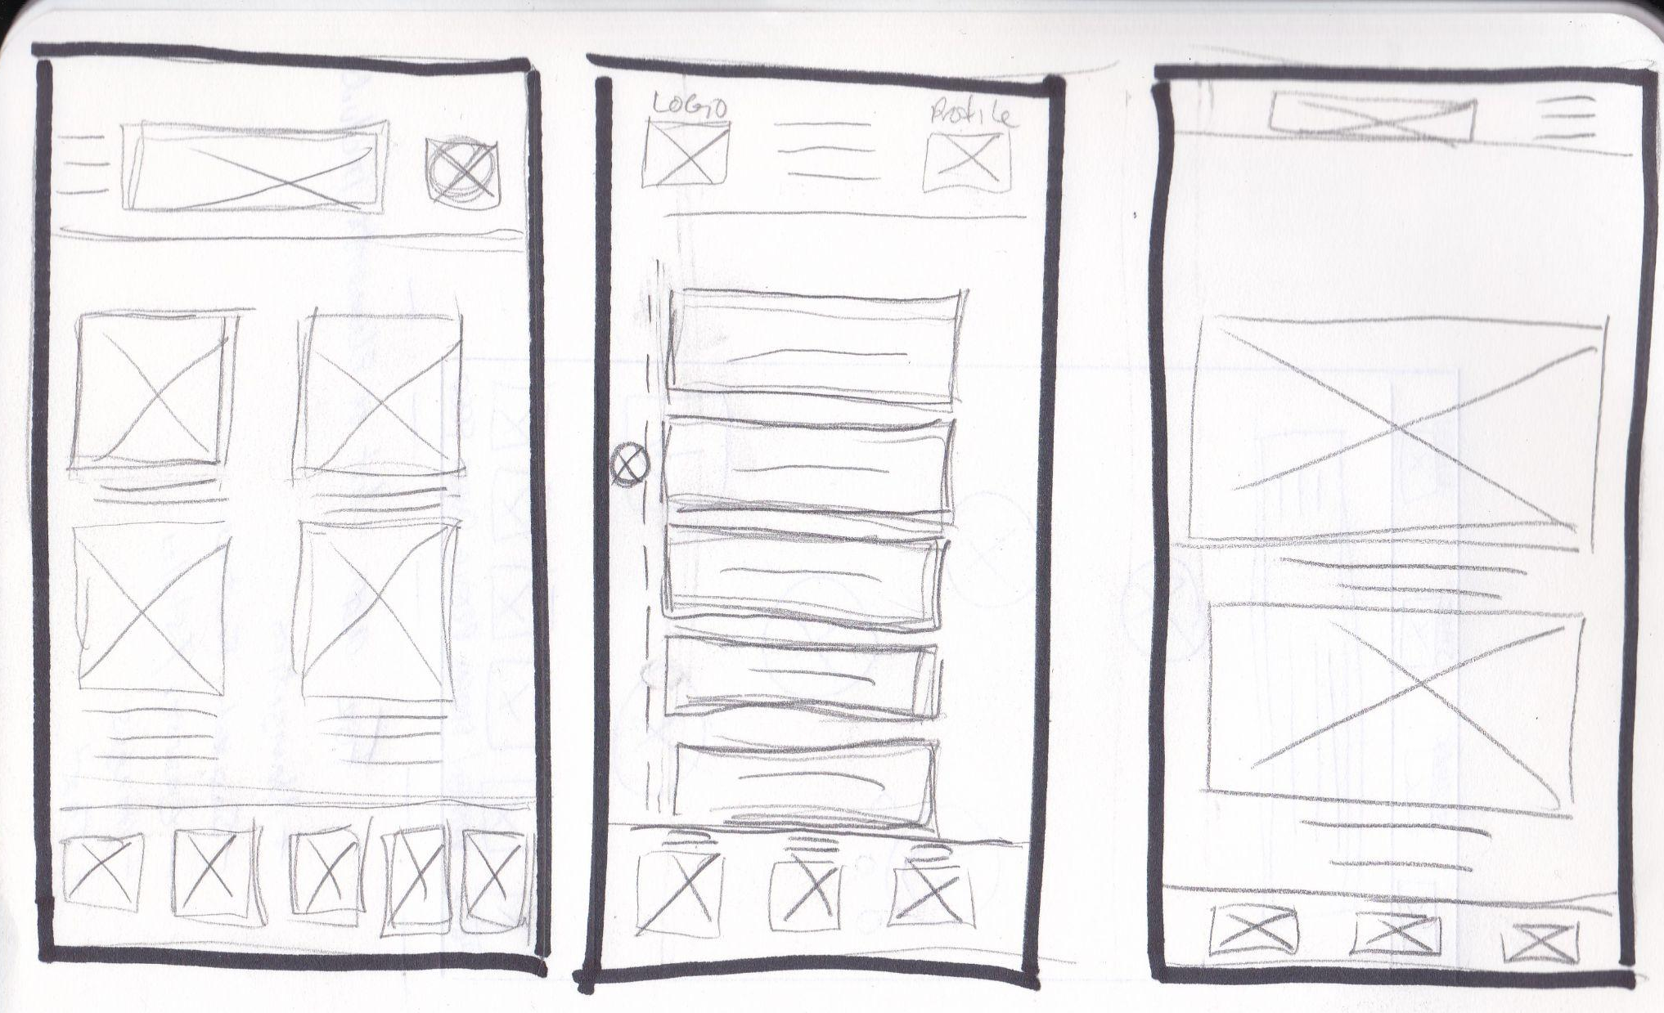
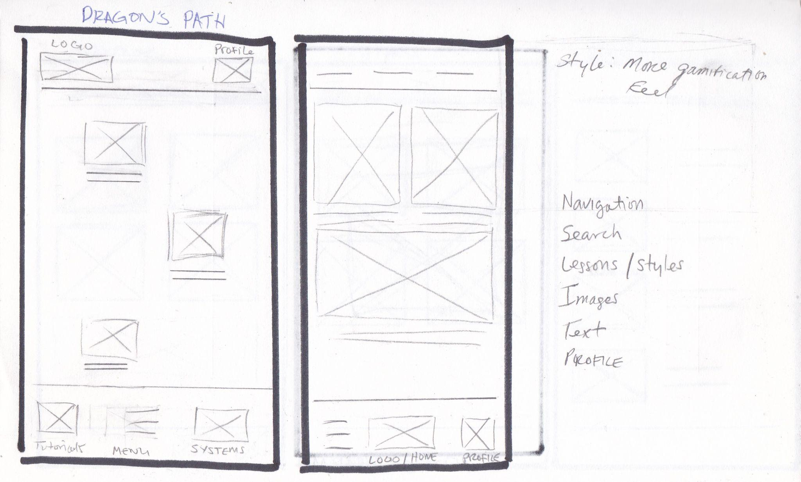
Paper wireframes
The goal for this paper wireframes is to create a simplistic design with a gamification feel style as the user progresses through the videos.

Slide 14
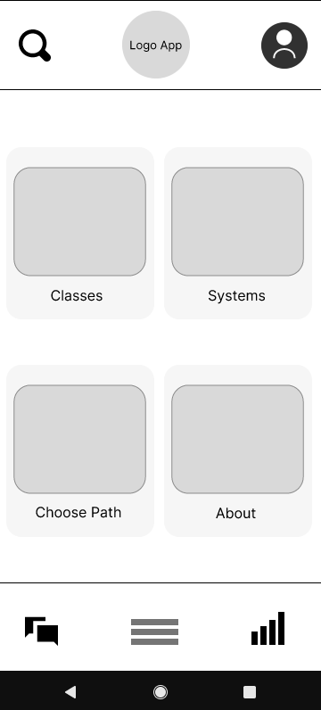
Digital wireframes
Search function to locate video or resources quickly instead of browsing
First Lo-Fi design; I wanted to keep the overall design simple, and minimalistic. I have the menu on the bottom middle; between the messaging icon and the progress icon. The search icon I place at the top left in case the user wanted to search for a video
Insert first wireframe example that demonstrates design thinking aligned with user research
User can get an description of the different styles that are offered

Slide 15
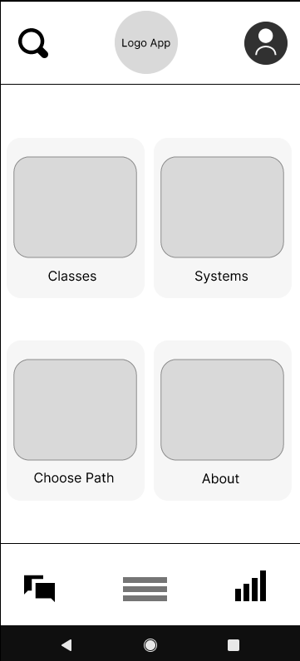
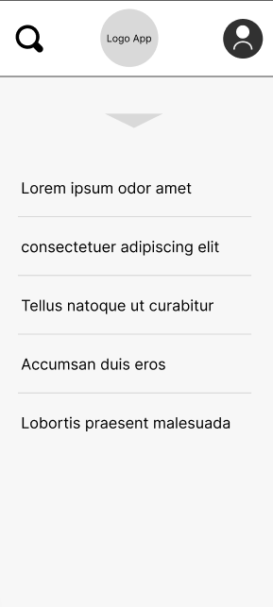
Digital wireframes
Profile icon on top right for users to log in
Based on the feedback, I decided to to add the contacts and search options to the menu instead of having them separate. This allowed to add more buttons to the bottom. I also moved the menu to the top left, and added the tutorials at the bottom
Easy of navigation showing menu options
Menu Access to navigation

Slide 16
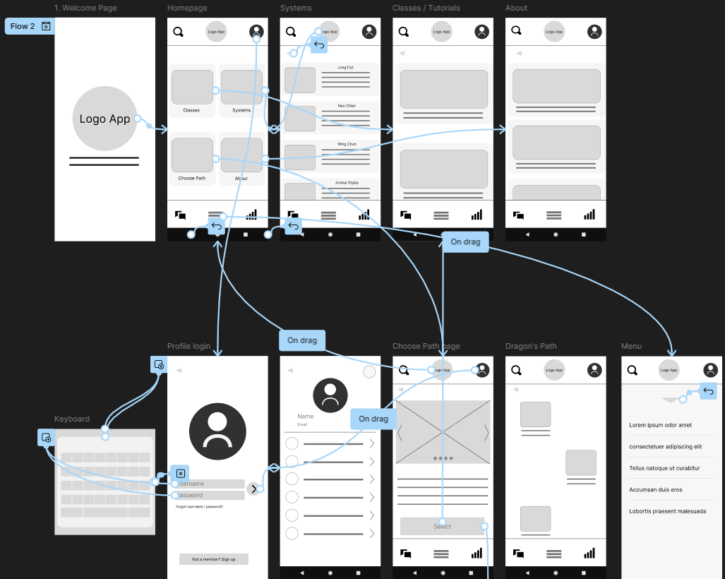
Low-fidelity prototype
The Low-Fidelity prototype connected to the user flow of the app to how the user navigate to the Martial arts video lessons.
Screenshot of prototype with connections or prototype GIF
To view the low-fidelity prototype, click the following link: Low-Fidelity prototype

Slide 17
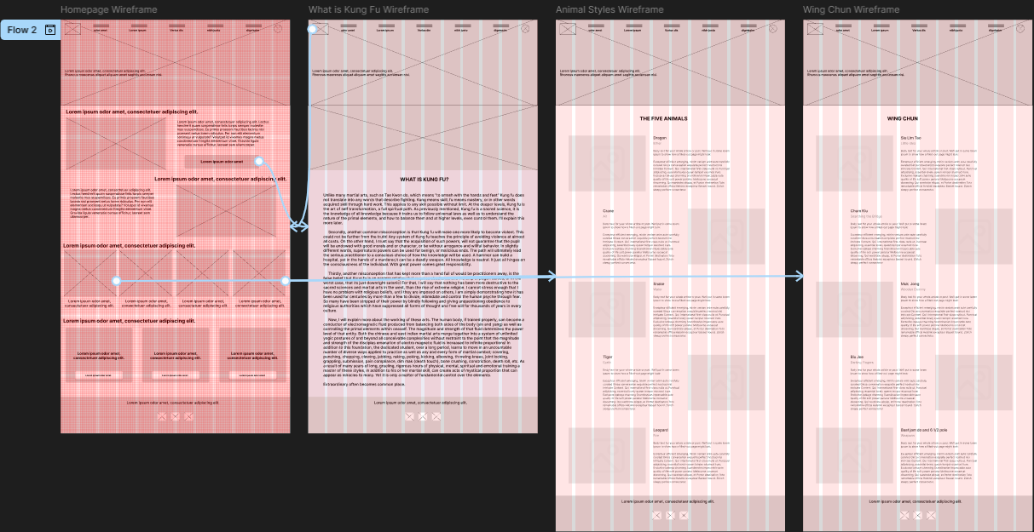
Low-fidelity prototype for website
The Low-Fidelity prototype connected to the user flow of the app to how the user navigate to the Martial arts website.
Screenshot of prototype with connections or prototype GIF
To view the low-fidelity prototype, click the following link: Low-Fidelity Website prototype

Slide 18
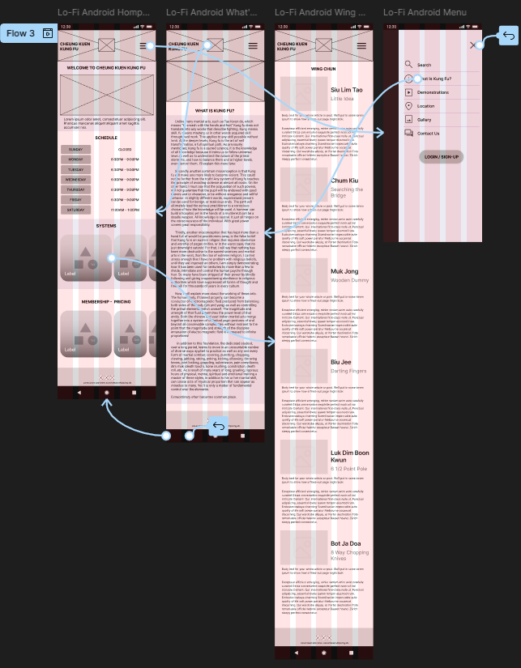
Low-fidelity prototype for website (mobile)
The Low-Fidelity mobile prototype connected to the user flow of the app to how the user navigate to the Martial arts website.
Screenshot of prototype with connections or prototype GIF
To view the low-fidelity prototype, click the following link: Low-Fidelity Mobile Website prototype

Slide 19
Usability study: findings
Once the initial mockups were developed, I went back to the users to evaluate the app's navigation and overall flow. Although they liked the interface's clean look, they considered the design overly simplistic and noted that the absence of a prominent search feature hindered their workflow significantly. Additionally, they expressed a desire for more features, including demo videos and the option for private lessons.
Round 1 findings
Round 2 findings
1
Was confused that the logo was the home button
1
Users wanted more visuals
2
Add a login page before homepage
2
Would like to see private lesson option
3
Add demonstration videos
3
Add confirmation page after private lesson

Slide 20
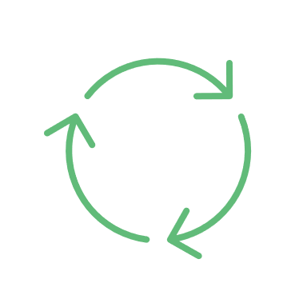
Refining
the design
Mockups
High-fidelity prototype
Accessibility

Slide 21
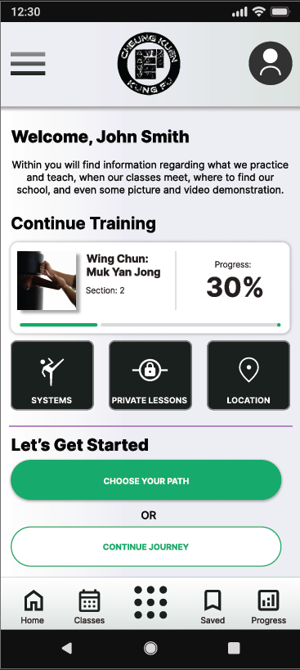
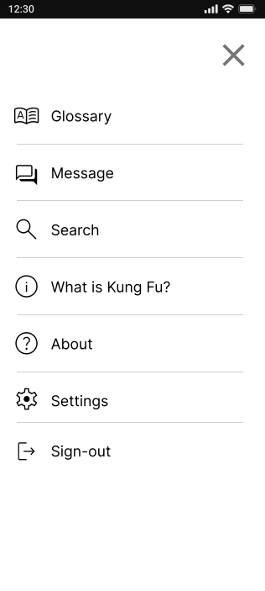
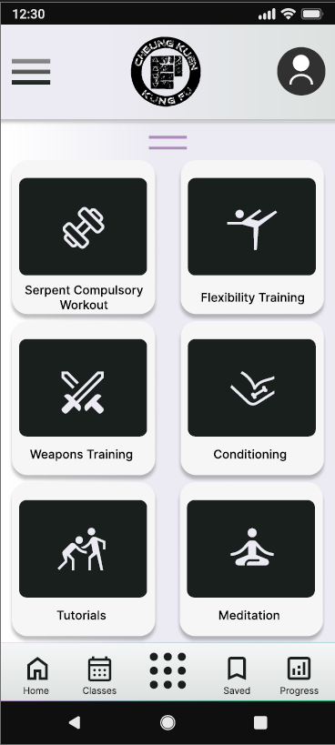
Mockups
Before usability study
After usability study
After the usability study the participants thought the design was too simple. They thought adding more to the homepage would lessen the confusion to where to homepage and find video lessons and resources.
I decided to move the menu to the top left of the homepage and added the search and message buttons. The tutorials, etc. on the bottom middle bar can be accessed by swiping up.

Slide 22
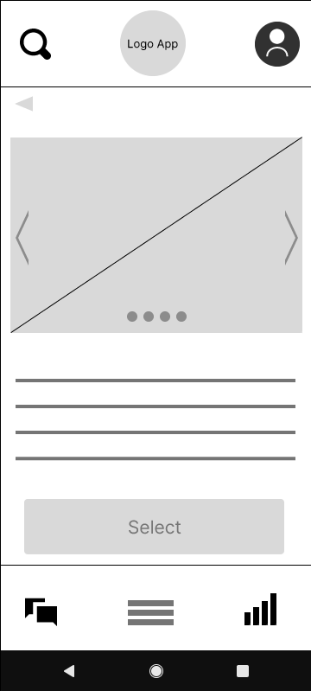
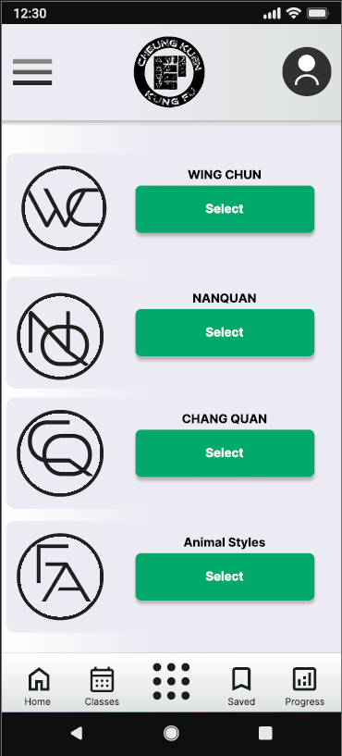
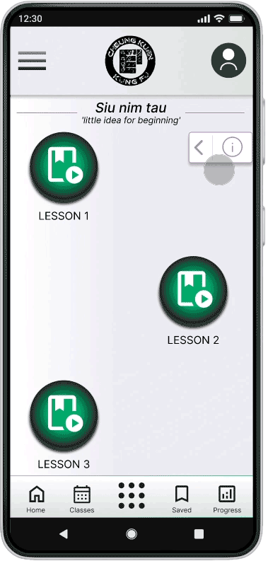
Mockups
Before usability study
After usability study
I initially wanted to do a carousel that side scrolls the different styles to select. I decided to have the styles all on one page to select. Upon clicking the option, a brief description of the will be available for the user to view.

Slide 23
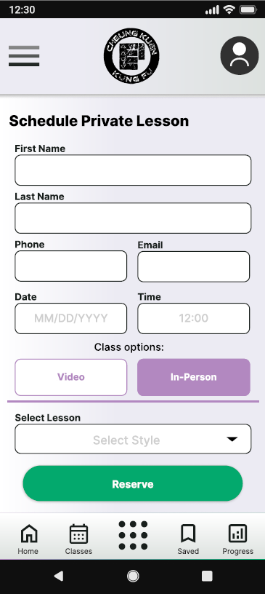
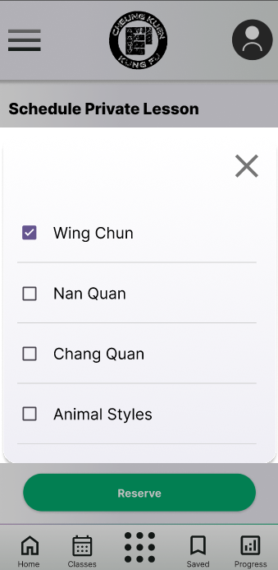
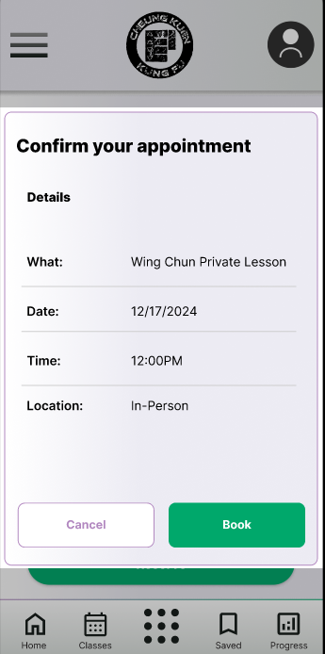
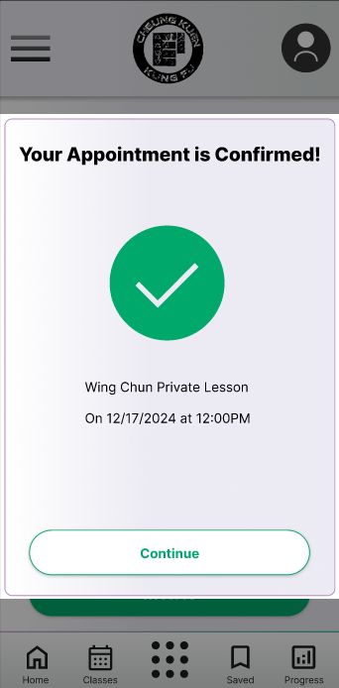
Mockups

Slide 24
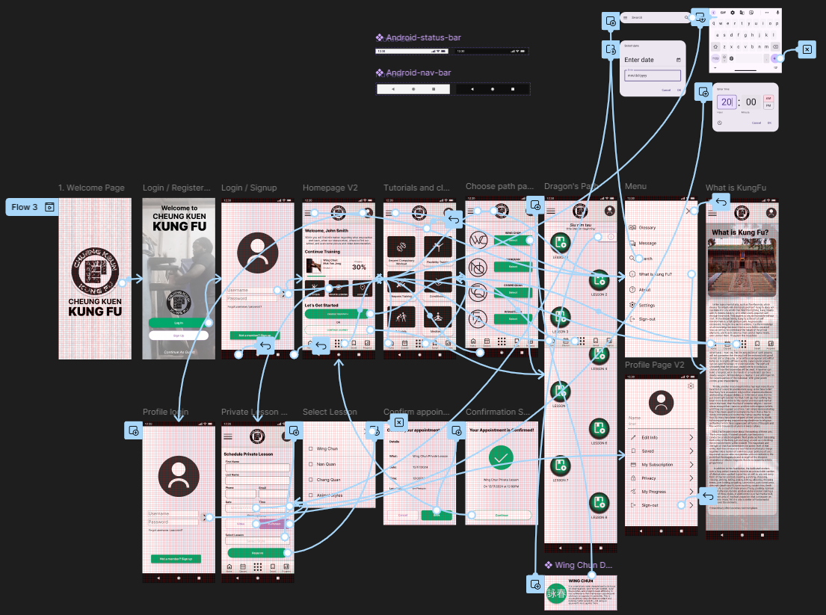
High-fidelity prototype
The High-Fidelity prototype connected to the user flow of the app to how the user navigate to the Martial arts video lessons.
To view the High-fidelity prototype, click the following link: High-Fidelity prototype

Slide 25
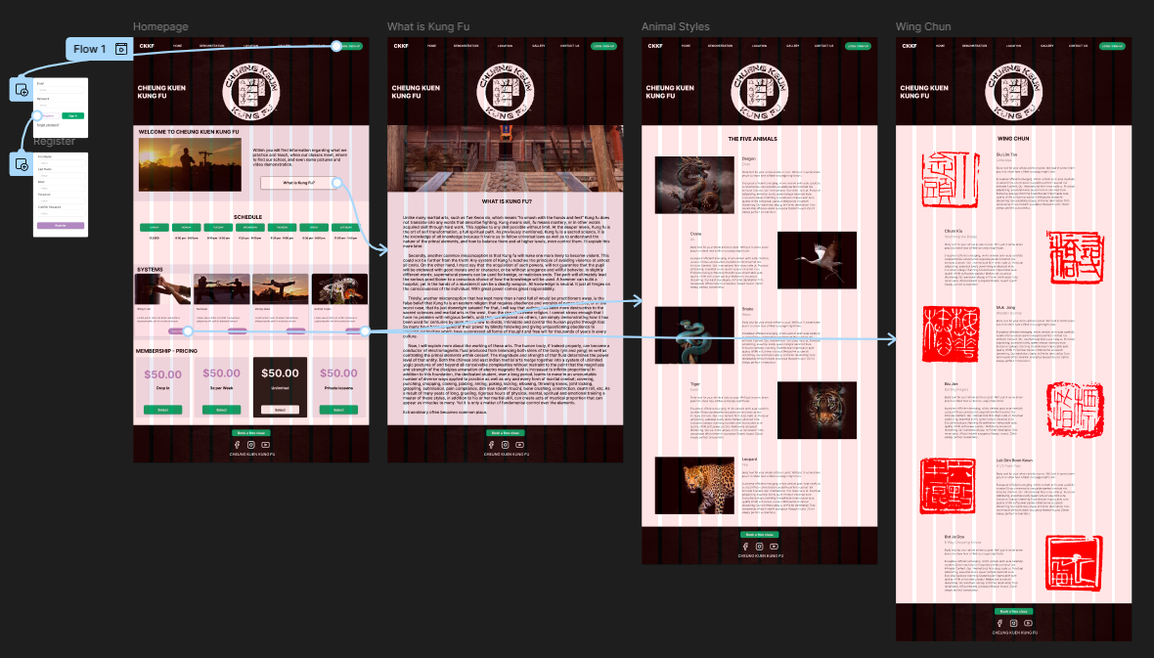
High-fidelity prototype
for Website
The High-Fidelity prototype connected to the user flow of the app to how the user navigate to the Martial arts website.
To view the High-fidelity prototype Website, click the following link: Website prototype

Slide 26
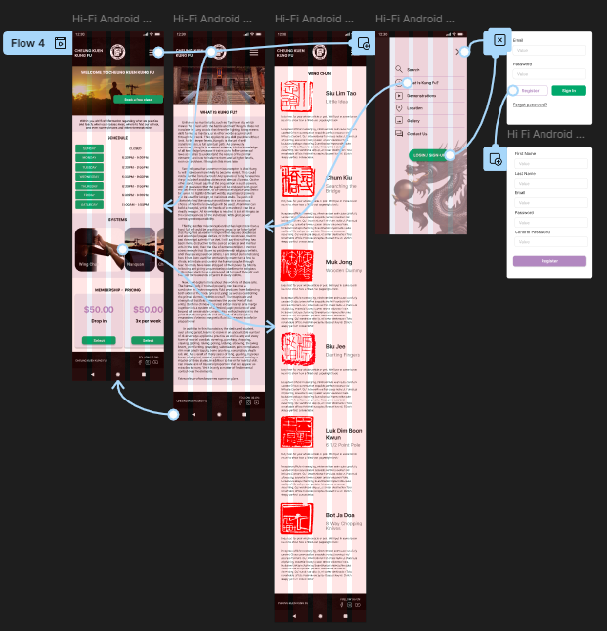
High-fidelity prototype for Website (mobile)
The High-Fidelity prototype connected to the user flow of the app to how the user navigate to the Martial arts website.
For the Mobile High-fidelity prototype Website, click the following link:
For Mobile Website prototype

Slide 27
Accessibility considerations
1
2
3
One of the considerations added were adding a transcript, and closed captioning for users to have for the video demonstrations and tutorials.
Implementing assistive technology like screen readers is another feature for the menu option. Using simple icons was chosen should the user have a visual disability
Adding speech to text is another consideration for the search option to provide another way to quickly look for a video lesson, or resource.

Slide 28

Going forward
Takeaways
Next steps

Slide 29

Takeaways
Impact:
It’s really amazing! I would definitely sign up when completed!
Participant A Feedback
What I learned:
Throughout this project I have learned how important research is when creating user experience. I gained a better understanding that the user must come first, then the design. Not the other way around. The persona portion was good to learn as it helps you to put yourself in the user’s shoes. Their feedback plays a critical role on what steps to take when iterating designs to create the best UX experience possible.

Slide 30

Next steps
1
2
3
Continue to refine the design to make it better. So, getting more user feedback to The end goal is to have a fully working UX design.
Improving the responsive website. Maybe adding more pages, using the feedback from the user participants.
Address the pain points the users provide to deliver the best design possible.

Slide 31
Let’s connect!
Thank you for taking the time out to view my UX Design project!
If you’d like to connect you my contact info are provided below:
Email: rjackson937@gmail.com
Linkedin: Robert Jackson

